Slide 1
PWM drawer
Aly Ehab El-Hamalawy

Slide 2
What is pwm
A Pulse Width Modulation (PWM) Signal is a method for generating an analog signal using a digital source. ... The frequency determines how fast the PWM completes a cycle (i.e. 1000 Hz would be 1000 cycles per second), and therefore how fast it switches between high and low states.

Slide 3
What is input capture mode
Input capture is a method of dealing with input signals in an embedded system. Embedded systems using input capture will record a timestamp in memory when an input signal is received. ... The interrupts can be programmed to occur at the rising or falling edge of the input signal, depending on requirements.

Slide 4

How can we calculate the frequency
For phase correct $f=\frac{f_{cpu}}{N∗510}$
For fast pwm $f=\frac{f_{cpu}}{N∗256}$

Slide 5
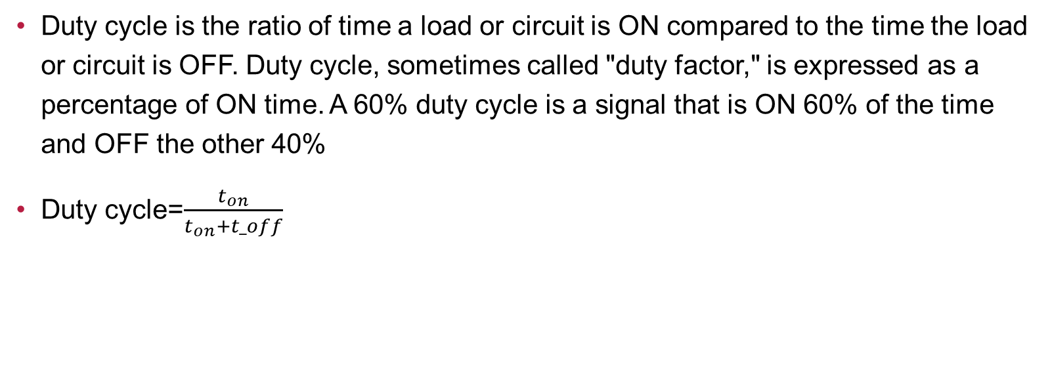
How to calculate the duty cycle
Duty cycle is the ratio of time a load or circuit is ON compared to the time the load or circuit is OFF. Duty cycle, sometimes called "duty factor," is expressed as a percentage of ON time. A 60% duty cycle is a signal that is ON 60% of the time and OFF the other 40%
Duty cycle=$\frac{t_{on}}{t_{on}+t_off}$

